Slide 2
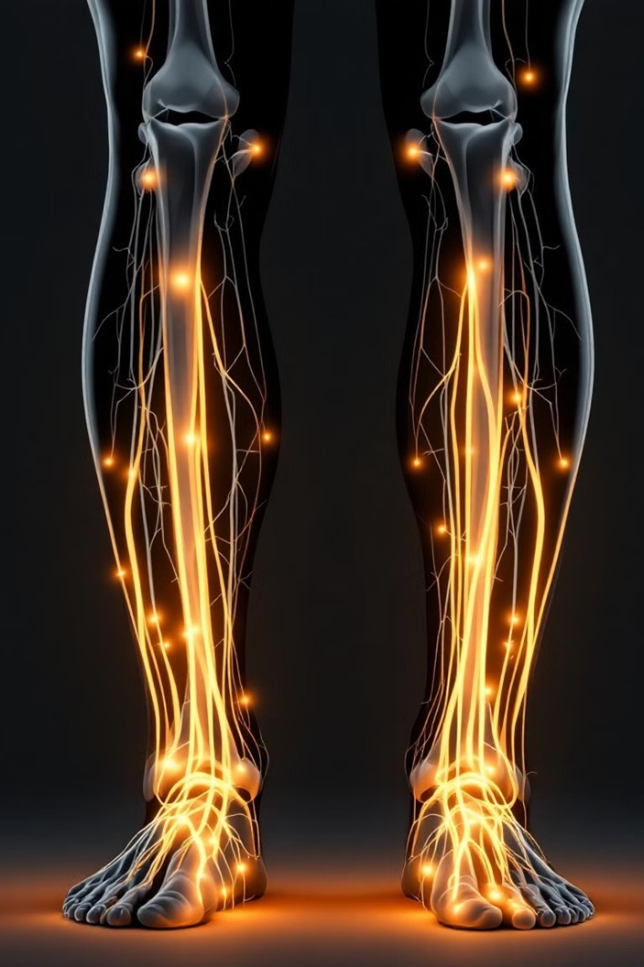
Diabetic neuropathy
Dr sevil ghaffarzadeh rad
Assistant professor of endocrinology

Slide 3
Diabetic neuropathy
Microvascular complication of diabetes mellitus (DM) Approximately 50% of persons with longstanding type 1 DM or type 2 DM develop symptomatic neuropathy.
Subclinical disease may be present in an even higher percentage of patients.
Usually becomes apparent after 5-10 years of diabetes
As cause of hospitalization

Slide 4
Pathophysiology of Diabetic Neuropathy
• Hyperglycemia → oxidative stress → nerve damage
• Microvascular dysfunction → reduced blood flow
• Inflammatory cytokines → pain & degeneration
• Mitochondrial dysfunction → impaired nerve repair

Slide 5
Risk factors
● Longer duration of diabetes mellitus
● Higher glycated hemoglobin levels
● Hypertension
● Obesity
● Dyslipidemia
● Tobacco use
● Chronic alcohol use
● Taller patient height
● Older age

Slide 6
Classification of diabetic neuropathies
Diffuse neuropathy | Mononeuropathy | Radiculopathy | Other neuropathies
DPN primarily small fiber | Isolated cranial or peripheral neuropathy | Thoracic radiculoneuropathy | Pressure neuropathies Entrapment
DPN primarily large fiber | Mononeuritis multiplex | Radiculoplexus neuropathy | CIDP
DPN mixed small and large fiber |  |  | Acute treatment induced neuropathy
DPN and autonomic neuropathy

Slide 8
Diabetic peripheral neuropathy (DPN)
The most common microvascular complications in both type1 and type 2 diabetes.
DPN has been defined as "the presence of symptoms and/or signs of peripheral nerve dysfunction in people with diabetes after the exclusion of other causes“
It is the most common component in the causal sequence to foot ulceration
DPN is largely concerned with the feet and lower limbs, although in some severe cases the hands may also be affected.
starts at the distal ends of the longest nerves with a stocking‐glove presentation

Slide 9
Distal symmetric polyneuropathy
sensorimotor polyneuropathy Motor symptoms are less common
Up to 50% of patients, may be asymptomatic
progressive reduction in the intra epidermal nerve fibers
this reduction is seen even in persons with prediabetes
up to one quarter of persons with IGT
increases with both age and duration of diabetes, and obesity.

Slide 10
DPN could be
positive (painful) symptoms:tingling, Burning,stabbing, pain,other abnormal sensation
negative (non painful) symptoms. Sensory loss ,Weakness,numbness
Decreased sensation →a predisposition to painless foot ulcers and subsequent amputations
The lifetime risk of a foot lesion in persons with DSP
►ulcer or gangrene (15 to 25% )
► imbalance and unsteadiness in gait (fall, lacerations, fractures, or traumatic brain injury)

Slide 11
Painful diabetic peripheral neuropathy
Occurs in 10 to 26%
can have a profound negative effect on:
quality of life
Sleep
mood
Occures more offen in:
High blood glucose levels
Age
Obesity
Smoking
Hypertension
dyslipidemia
peripheral artery disease

Slide 12
Clinical MANIFESTATIONS
Large nerve fiber loss : impairment of vibratory sensation , proprioception, reduced ankle reflexes
Small nerve fiber loss :impairment of pain, light touch, and temperature sensation
The duration and severity of hyperglycemia and components of the
metabolic syndrome are major risk factors for the development of
diabetic neuropathy.
some persons may be asymptomatic, and signs of disease may be
detected only by means of a detailed neurologic examination.
Mild muscle wasting
severe weakness is rare

Slide 14
 | Large fiber neuropathy | Small fiber neuropathy
Symptom | Numbness, tingling, gait instability | Burning pain, electrical shock, stabbing pain
Examination | Reflexes, proprioception, vibration | Temperature, pinprick sensation
Function | Pressure, balance, muscle strength | Pain sensation, protective sensation
Diagnostic test | Nerve conduction studies DPN Check™ (point-of-care device assessing sural nerve conduction) Neurothesiometer Tuning fork (128 Hz) | Quantitative sensory testing (QST) Intradermal nerve fiber structure Laser Doppler imaging after noxious stimulus Sudomotor function Skin conductance measurement Microneurography

Slide 17
Evaluation OF DSP
• History: Previous ulcer/lower extremity amputation, claudication
• Vascular status: palpation of pedal pulses
• Loss of protective sensation (LOPS): assess with one of the following technique:
- Pressure perception: Semmes-Weinstein 10 gram monofilament
- Vibration perception: 128 Hz tuning fork
- When monofilament or tuning fork are not available test tactile sensation: lightly touch the tips of the toes of the patient with the tip of your index finger for 1–2 seconds LOPS is usually caused by diabetic polyneuropathy.

Slide 18
Key components of the diabetic foot exam
Inspection
Dermatologic
Skin status: color, thickness, dryness, cracking
Sweating
Infection: check between toes for fungal infection
Ulceration
Calluses/blistering: hemorrhage into callus?
Musculoskeletal
Deformity, eg, claw toes, prominent metatarsal heads, Charcot joint
Muscle wasting (guttering between metatarsals)
Neurological assessment
10 g monofilament + one of the following four
Vibration using 128 Hz tuning fork
Pinprick sensation
Ankle reflexes
Vascular assessment
Foot pulses Capillary response
ABI, if indicated

Slide 19
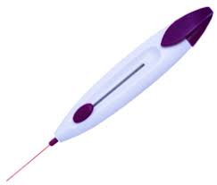

Slide 21
Skin and joint signs
Progressive loss of protective sensation predisposes to ulcer formation .
Foot ulcers are usually classified into two groups:
Acute ulcers
Chronic ulceration is multifactorial
a combination of diabetic polyneuropathy (with decreased pain sensation), autonomic dysfunction, and vascular insufficiency.
Distal motor axonal loss results in atrophy of intrinsic foot muscles and an imbalance between strength in toe extensors and flexors. This ultimately leads to chronic metatarsal-phalangeal flexion (claw-toe deformity) which shifts weight to the metatarsal heads .This weight shift results in formation of calluses that can fissure, become infected and ulcerate.

Slide 23
Who should be screened?
All patients with diabetes should be screened for polyneuropathy at the time of diagnosis of type 2 diabetes and five years after the diagnosis of type 1 diabetes .
Patients with prediabetes who have symptoms of polyneuropathy should also be screened after initial screening
All patients with type 2 or type 1 diabetes who do not have polyneuropathy should be screened at least annually for the development of neuropathy

Slide 24
Risk classification based on the comprehensive foot examination
Category | Ulcer Risk | Characteristics | Frequency
0 | Very low | No LOPS and No PAD | Once a year
1 | Low | LOPS or PAD | Once every 6-12 months
2 | Moderate | LOPS + PAD, or LOPS + foot deformity, or PAD + foot deformity | Once every 3-6 months
3 | High | LOPS or PAD, and one or more of the following: - history of a foot ulcer - a lower-extremity amputation (minor or major) - end-stage renal disease | Once every 1–3

Slide 25
Should be carefully assessed for other conditions:
Asymmetric symptoms or signs
Greater impairment of motor function than sensory function,
Entrapment
Rapid progression
Severe weakness
Drug
Chemical exposures
Family history of inherited neuropathies

Slide 26
Differential Diagnosis
Uremia
Vitamin B12 deficiency
Alcoholism Critical illness
Cervical myelopathy
Lumbar stenosis
Tarsal tunnel syndrome
Carpal tunnel syndrome
Raynaud syndrome
Chronic liver disease
Guillain-Barré syndrome
(CIDP)
Carcinoma
HIV infection
Lyme disease
Lymphoma
Multiple myeloma
Monoclonal gammopathy
Drugs: cisplatin, hydralazine, isoniazid, metronidazole, nitrofurantoin, phenytoin, nucleoside analogues,, "statins" vincristine, amiodarone, dapsone, disulfiram
Malabsorption
Toxins: alcohol,, arsenic, diphtheria toxin, lead,mercury, organophosphates, thallium

Slide 27
Objective testing for neuropathy
Measurement of nerve-conduction velocities NCV
Quantitative measures of small fiber nerves:تشخیص زودهنگام: SFNs می‌توانند قبل از اینکه علائم بالینی واضح شوند، آسیب ببینند. اندازه‌گیری آنها می‌تواند به تشخیص زودهنگام بیماری‌ها و شروع درمان به موقع کمک کند.
ارزیابی شدت بیماری: اندازه‌گیری SFNs می‌تواند به ارزیابی شدت بیماری و پیش‌بینی پیشرفت آن کمک کند.
Quantitative sensory testingاین تست شامل مجموعه‌ای از روش‌ها است که برای ارزیابی پاسخ‌های حسی به محرک‌های مختلف مانند گرما، سرما، فشار و ارتعاش استفاده می‌شوند. این تست می‌تواند به شناسایی اختلالات در عملکرد اعصاب فیبر کوچک کمک کند.
Thermal Sensory Analyzer
Vibratory Testing Device
پیگیری پاسخ به درمان
Skin Bx
OCT (Optical Coherence Tomography) این روش تصویربرداری غیرتهاجمی می‌تواند برای بررسی ضخامت و ساختار لایه
عصبی شبکیه چشم استفاده شود که می‌تواند تحت تأثیر SFNs قرار گیرد.
Sudomotor testاین تست عملکرد غدد عرق را بررسی می‌کند که توسط اعصاب فیبر کوچک کنترل می‌شوند. کاهش تعریق می‌تواند نشانه‌ای از آسیب به این اعصاب باش
Tests of autonomic function is required to make a definitive diagnosis of neuropathy, although it is not essential for clinical care.

Slide 28
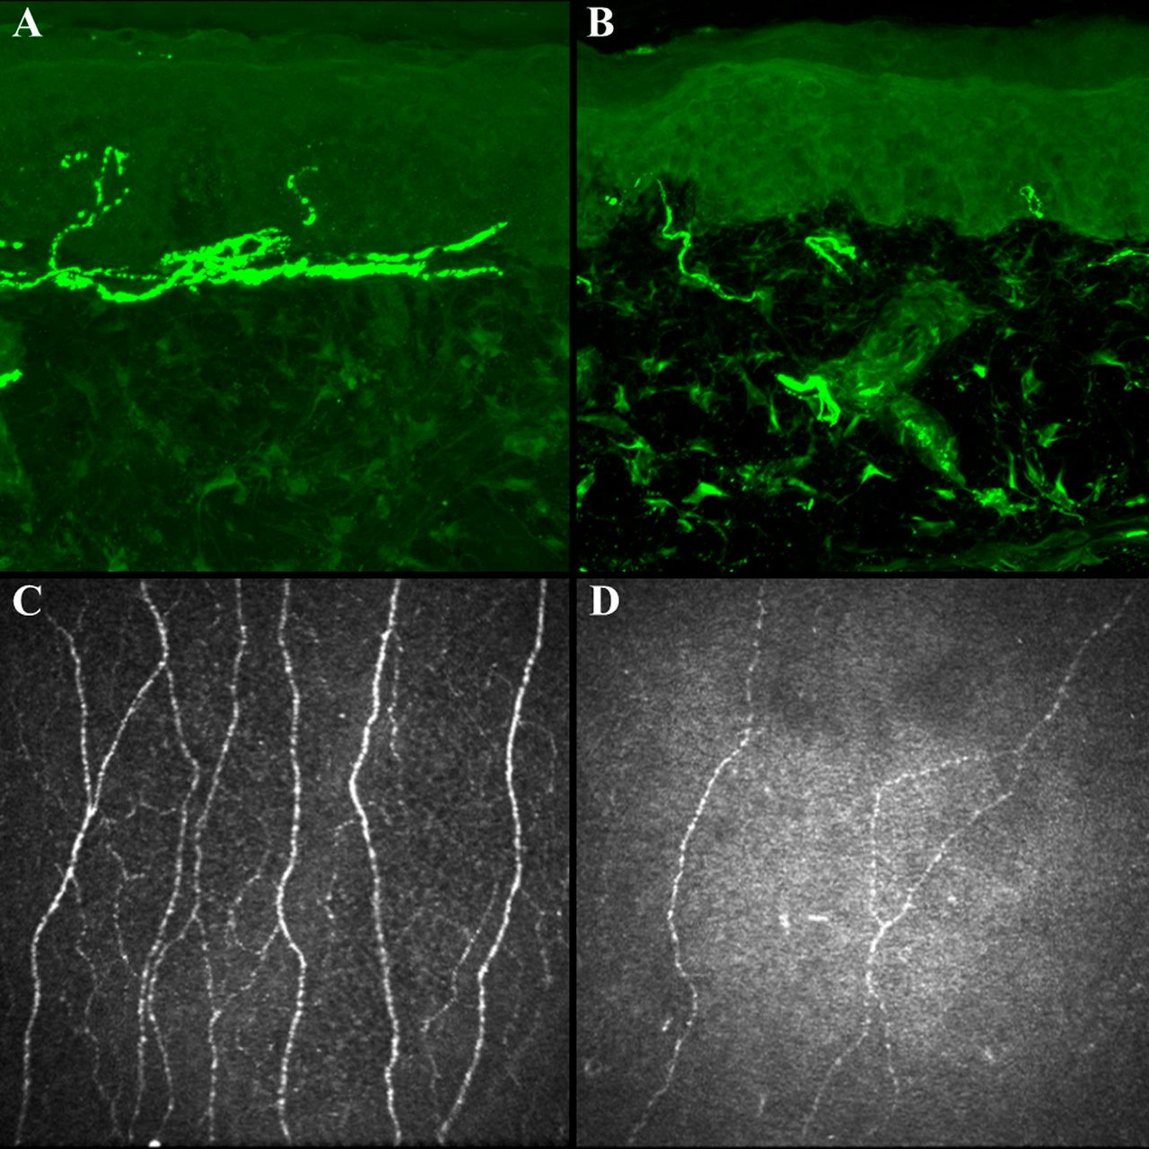
Quantitative measures of small fiber nerves.
Roni M. Shtein, and Brian C. Callaghan Diabetes 2013;62:25-26
©2013 by American Diabetes Association
Notes:
Quantitative measures of small fiber nerves. Quantitative measures of small fiber nerves include immunohistochemical stain (PGP 9.5, magnification ×40) of skin biopsy specimens from the distal leg to illustrate IENFD in a healthy subject (A) and a patient with severe diabetic neuropathy (B), and representative CCM images from a healthy subject (C) and a patient with severe diabetic neuropathy (D).

Slide 29
Quantitative assessment of small fiber damage is key to the early diagnosis and assessment of progression or regression of diabetic sensorimotor polyneuropathy (DSPN).
Intraepidermal nerve fiber density (IENFD) is the current gold standard, but corneal confocal microscopy (CCM), an in vivo ophthalmic imaging modality, has the potential to be a noninvasive and objective image biomarker for identifying small fiber damage
ارزیابی کمی آسیب فیبر کوچک برای تشخیص زودهنگام و ارزیابی پیشرفت یا پسرفت پلی نوروپاتی حسی حرکتی دیابتی (DSPN) کلیدی است. تراکم فیبر عصبی داخل اپیدرمی (IENFD) استاندارد طلایی فعلی است، اما میکروسکوپ کانفوکال قرنیه (CCM)، یک روش تصویربرداری چشمی in vivo، این پتانسیل را دارد که یک بیومارکر تصویر غیرتهاجمی و عینی برای شناسایی آسیب‌های کوچک فیبر باشد

Slide 30
Laboratory studies
TSH
CBC
serum levels of folate and vitamin B12
Glucose, Hemoglobin A1C1, lipid
Serum immunoelectrophoresis
The results of which are often abnormal in patients with chronic inflammatory demyelinating polyneuropathy, which is a common condition in persons with diabetes.

Slide 31
Diabetic polyradiculopathy
Severe disabling pain in distribution of ≥ 1 nerve roots May be accompanied by motor weakness
Lumbar radiculopathy (diabetic amyotrophy) is most common form.
May cause pain in thigh with subsequent proximal weakness in the affected leg
Self-limited; usually resolves within 6 months to 2 years
Intercostal or truncal radiculopathy causes pain over thorax or abdomen.

Slide 32
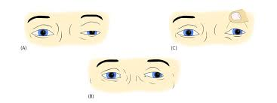
Mononeuropathy
Dysfunction of isolated cranial or peripheral nerves ,Much less common than polyneuropathy
Presents with pain and motor weakness in distribution of a single nerve
Vascular etiology has been suggested.
Involvement of the third cranial nerve is most common.
Heralded by diplopia
Physical examination reveals: Ptosis Ophthalmoplegia
Normal pupillary constriction to light
Cranial nerves IV, VI, or VII (Bell's palsy) are less frequently affected.
Mononeuropathy multiplex: simultaneous involvement of > 1 nerve

Slide 34
Autonomic neuropathy
At the time of diabetes diagnosis in up to 7 percent but can be as high as 50 percent after 15 years SCREENING is recommended for all patients with diabetes.
Early recognition of clinical or subclinical DAN is useful for risk stratification and to guide specific glycemic, lipid, and blood pressure targets
We screen for DAN at the time of diagnosis of type 2 diabetes and 5 years after the diagnosis of type 1 diabetes
Screening:+ directed testing may be performed to help establish the diagnosis of DAN
_ a history and physical examination for symptoms
and signs of autonomic dysfunction should be repeated annually

Slide 36
CARDIOVASCULAR AUTONOMIC NEUROPATHY
Resting tachycardia and exercise intolerance
As autonomic neuropathy progresses, the resting heart rate gradually slows .Cardiac denervation can occur in diabetic patients with advanced autonomic neuropathy.
fixed heart rate (80 to 90), elevated risk of painless myocardial infarction, arrhythmias, sudden death
Postural tachycardia
Orthostatic hypotension
Intermittent dizziness
Supine hypertension
Postprandial hypotension Syncope.
CAN may also be associated with kidney disease and cerebrovascular events

Slide 37
Diagnostic Tests for Cardiovascular Autonomic Neuropathy
Resting Heart Rate Rate >100 beats/min is abnormal.
Beat-to-Beat Heart Rate Variation: With the patient at rest and supine (no overnight coffee or hypoglycemic episodes), breathing 6 breaths/min, heart rate monitored by ECG, an HRV of >15 beats/min is normal and <10 beats/min is abnormal, E/I ratio of R-R intervals >1.17. All indices of HRV are age-dependent
Heart Rate Response to Standing During continuous ECG monitoring, the R-R interval is measured at beats 15 and 30 after standing. Normally, a tachycardia is followed by reflex bradycardia. The 30:15 ratio is normally >1.03
Heart Rate Response to Valsalva Maneuver The subject forcibly exhales into the mouthpiece of a manometer to 40 mm Hg for 15 seconds during ECG monitoring. Healthy subjects develop tachycardia and peripheral vasoconstriction during strain and an overshoot bradycardia and rise in blood pressure with release. The ratio of longest to shortest R-R interval should be >1.2
Systolic Blood Pressure Response to Standing Systolic blood pressure is measured in the supine subject. The patient stands and the systolic blood pressure is measured after 2 min. Normal response is a fall of <10 mm Hg, borderline is a fall of 10-29 mm Hg, and abnormal is a fall of >30 mm Hg with symptoms
Diastolic Blood Pressure Response to Isometric Exercise he subject squeezes a handgrip dynamometer to establish a maximum. Grip is then squeezed at 30% maximum for 5 min. The normal response for diastolic blood pressure is a rise of >16 mm Hg in the other arm
Electrocardiographic QT/QTc Intervals The QTc (corrected QT interval on ECG) should be <440 ms.
Neurovascular Flow Noninvasive laser Doppler measures peripheral sympathetic responses to nociception داپلر لیزری غیرتهاجمی پاسخ های سمپاتیک محیطی به درد را اندازه گیری می کند

Slide 38
Diagnostic testing
● Possible or early CAN : one abnormal cardiovascular reflex test .
● Definite or confirmed CAN : two abnormal cardiovascular reflex tests ● Severe or advanced CAN :definite CAN and the additional presence of orthostatic hypotension

Slide 39
PROGNOSIS
● Diminished perception of cardiac ischemia among patients with diabetes .
● Impaired cardiovascular response to physiologic stressors such as surgery or infection .
● Arrhythmogenicity due to alterations in vagal control of heart rhythm or QT interval .
● Denervated myocardial tissue that has focal areas of reinnervation at increased risk for arrhythmia .

Slide 40
Sudomotor Function Tests
1. Quantitative Sudomotor Axon Reflex Test (QSART)
- Measures sweat production via acetylcholine stimulation
- Abnormal: Reduced or absent sweating
2. Thermoregulatory Sweat Test (TST)
- Heat chamber test using indicator powder
- Abnormal: Patchy or absent sweating
3. Electrochemical Skin Conductance (ESC) Test
- Evaluates sweat gland function using skin electrodes

Slide 41
Gastrointestinal Autonomic Function Tests
1. Gastric Emptying Scintigraphy
- Monitors radiolabeled meal digestion
- Abnormal: >10% retention at 4 hours
2. Smart Pill Test
- Wireless capsule measures gut transit time

Slide 42
Genitourinary Autonomic Function Tests
1. Post-Void Residual Volume (PVR) Test
- Ultrasound or catheterization after urination
- Abnormal: >100 mL residual urine
2. Urodynamic Testing
- Measures bladder pressure and voiding function
3. Penile/Vaginal Biothesiometry
- Assesses sensory nerve function

Slide 43
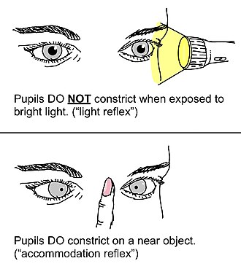
Pupillometry (Autonomic Pupillary Testing)
• Measures pupillary light reflex using infrared technology
• Abnormal: Delayed constriction or dilation
• Useful for early autonomic dysfunction detection
Argyll Robertson pupils

Slide 45
Sympathetic nervous system dysfunction and other manifistations
Hyperhidrosis of upper extremities
Anhidrosis of lower extremities
Increases risk of foot ulcers
Reduction of counterregulatory hormone release (especially epinephrine) may decrease ability to sense adrenergic hypoglycemic symptoms.
Hypoglycemia unawareness
Difficulty with night driving – Dysfunction in pupillary constrictor muscles may result in failure in dark adaptation
Acral symptoms (hyperthermia, pruritus, aching, cramping)
Skin changes (dry skin, venous prominence, callus formation, loss of nails)
Peripheral edema, associated with foot ulceration and/or poor wound healing Neuroarthropathy (Charcot arthropathy)

Slide 46
Charcot arthropathy
Collapse of the arch of the midfoot and bony prominences leading to fragmentation and sclerosis of bone,new bone formation,subluxation, dislocation, and stress fractures.

Slide 48
GASTROINTESTINAL AUTONOMIC NEUROPATHY
Gastroesophageal reflux disease (GERD)
Gastroparesis: Anorexia ,Nausea ,Vomiting,Early satiety
Diarrhea watery and painless, occurs at night, and may be associated with fecal incontinence. DIABETIC DIARRHEA:
Disordered motility
Increased intestinal secretion
Small intestinal bacterial overgrowth (SIBO)
Fecal incontinence
Medications – Medications such as metformin, alpha-glucosidase inhibitor, glucagon-like peptide [GLP]-1 agonist, and dipeptidyl peptidase-4 [DPP4] inhibitors) and artificial sweeteners (eg, sorbitol or polyols)

Slide 50
GENITOURINARY AUTONOMIC NEUROPATHY
Bladder-emptying abnormalities
Inability to sense full bladder
Failure to void completely
Urinary hesitancy
Decreased voiding frequency
Incontinence
Recurrent urinary tract infections
Sexual dysfunction
Erectile dysfunction
Dyspareunia Vaginal dryness
Retrograde ejaculation

Slide 51
Diabetic neuropathy management
Management of painful distal symmetric polyneuropathy

Slide 52
Nonpharmacologic
Lifestyle interventions may prevent or possibly reverse neuropathy.
diet
Exercise
blood pressure and blood glucose levels control
rational glycemic control is recommended to manage symptoms and prevent further damage, including falls and foot ulcers.
An overly rapid lowering of blood glucose levels (a reduction of >1% per month in hemoglobin A1C level) may induce a neuritis with severe pain, although the neuritis generally resolves within 6 months.

Slide 53
Pharmacotherapy
First-line monotherapy frequently does not provide satisfactory relief at maximally tolerated doses.
Switching to a different agent within the same class
Switching to a new class
Adding a second agent.
Best evidence for efficacy of short-term pain relief is with tricyclic antidepressants and traditional anticonvulsants

Slide 54
Pharmacotherapy
Anticonvulsants
Antidepressants
SNRIs
Tricyclic agents
Opioids
Capsaicin 8.0% patch

Slide 55
Topical Capsaicin
Capsaicin 0.075% cream (was not effective)
An 8.0% patch (pain relief)
applied to painful areas 4 times daily
Might damage C-type fibers originating in the skin
pain relief that began within a few days and
persisted for 3 to 6 months after a single application
Adverse effects: local burning and transient skin irritation

Slide 56
Anticonvulsants
Gabapentin and pregabalin are:
α2δ2 voltage-gated calcium modulators
improving sleep

Slide 57
Gabapentin
Gradual adjustment to the dose that is usually clinically effective (300-600 mg PO tid)
Adverse effects: fatigue, weight gain, back pain, central nervous system effects
Contraindications: Use with caution in patients with renal impairment

Slide 58
Pregabalin
In contrast to gabapentin, pregabalin has linear and dose-proportional absorption in the therapeutic dose range (150 to 600 mg per day)
more rapid onset of action than gabapentin
more limited dose range that requires less adjustment.
Adverse effects: dizziness, somnolence, peripheral edema, blurry vision, weight gain
FDA approved for pain associated with diabetic neuropathy

Slide 59
Topiramate
reduce the intensity of pain
improve sleep
stimulates the growth of intraepidermal nerve fibers of 0.5 to 2.0 fibers per millimeter per year, as compared with a decline of 0.5 to 1.0 fibers per millimeter per year in untreated patients
weight loss (improvements in lipid levels and blood pressure )

Slide 60
Tricyclic Antidepressants
Mechanisms that are unrelated to their antidepressant effects
Adverse cholinergic effects .palpitations, hypertension, irritability, dry mouth
Nortriptyline and Desipramine > amitriptyline or imipramine
used with caution (suspected cardiac disease)
ECG (QT-interval prolongation and rhythm disturbances)
Contraindications: presence of cardiovascular disease,
severe respiratory disease, Parkinson's disease, concomitant use of monoamine oxidase inhibitors
Nortriptyline (25-150 mg/d PO)

Slide 61
Serotonin–Norepinephrine Reuptake Inhibitors (SNRIs)
Venlafaxine
Duloxetine
Duloxetine (60-120 mg/d PO)
Adverse effects: nausea, somnolence, dizziness, anorexia, constipation
FDA approved for pain associated with diabetic neuropathy
Contraindications:Substantial alcohol use and/or evidence of chronic hepatic disease
Use with caution in patients with cardiac disease.

Slide 62
Opioid Analgesics
risks of abuse addiction, and diversion
only in selected cases and only after other medications have failed to be effective

Slide 63
Tramadol
an atypical opiate analgesic
inhibits the reuptake of norepinephrine and serotonin
only in selected cases lower potential for abuse than other opioids

Slide 64
Tapentadol
Extended-release tapentadol
has similar actions and has been approved
for the treatment of diabetic neuropathic
pain by the Food and Drug Administration

Slide 65
Gabapentin + sustained-release morphine
better analgesia at lower doses of each drug than the use of either drug alone
but was accompanied by an increase in adverse effects, including constipation, sedation, and dry mouth.

Slide 66
Coexisting Conditions and Choice of Therapy
choosing therapy:
sleep loss →pregabalin and gabapentin
depression→SNRI or a TCA
anxiety→Pregabalin, gabapentin, or an SNRI
Pain → TCA, SNRI

Slide 67
Autonomic neuropathy management
Glycemic control
Treating comorbid vascular risk factors (hypertension, hyperlipidemia, obesity,smoking)
Addressing specific autonomic symptoms to provide symptomatic relief and reduce associated morbidity
Glycemic targets For individuals with chronic hyperglycemia, to achieve a target hemoglobin A1C gradually, not exceeding a 3-point change in hemoglobin A1C in three months Extremely rapid improvements in glycemic control in patients with chronic
This phenomenon is called treatment-induced neuropathy of diabetes (TIND)

Slide 68
Autonomic neuropathy treatment
Nonpharmacologic symptomatic treatment
• Detailed review and removal of any medications that may worsen orthostatic hypotension .
• Increase in fluid intake and liberalize salt intake.
• Modify daily activities (eg, stand upright slowly, elevate head of bed, flex hands and/or feet before standing).

Slide 69
Examples of medications that may cause or exacerbate orthostatic hypotension
Diuretics
Adrenergic antagonists terazosin,propranolol
Alpha-2-adrenergic agonists (eg, tizanidine, clonidine)
Nitricoxidemediated vasodilator nitroglycerin,hydralazine
Phosphodiesterase-5-inhibitors (eg, sildenafil)
Renin-angiotensin system (RAS) inhibitors (eg, lisinopril, valsartan)
Calcium-channel blockers (eg, verapamil, diltiazem)
Dopamine antagonists,Phenothiazines,Atypical antipsychotics
Antidepressants (eg, trazodone, amitriptyline)
selective serotonin receptor reuptake inhibitors (eg, paroxetine)
Sodium-glucose co-transporter 2 inhibitors (eg, empaglifozin, canaglifozin)

Slide 70
Pharmacologic symptomatic treatment
Orthostatic Hypotension | Clonidine Octreotide Fluorohydrocortison
Gastroparesis | Metoclopramide Domperidone Erythromycin
Diabetic Diarrhea | Metronidazole Clonidine Cholestyramine Loperamide Octreotide
Cystopathy | Bethanechol Doxazosin
Erectile Dysfunction | Sildenafil

Slide 71
Treatment of sudomotor
is generally supportive
lifestyle modifcations such as cooling garments and avoidance of warm environments can improve symptoms.
Clinicians should avoid the temptation to treat a proximal compensatory hyperhidrosis because treatment increases the risk of hyperthermia

Slide 72
Areas of Uncertainty
Benefits and risks of agents
Combination of methylcobalamin, methylfolate, and pyridoxal phosphate
Metformin
oxidative and nitrosative stress
Whereas neuropathy associated with vitamin B12 deficiency has typically been considered to occur at levels below 250 pg per milliliter, one study indicated that the threshold for the development of impaired nerve conduction is approximately 450 pg per milliliter.2000 μg per day could be initiated
Alpha lipoic acid can be given to relieve pain (starting at a twice-daily oral dose of 300 mg)

Slide 73
Emerging Therapies
• α-Lipoic Acid – Antioxidant, some nerve function improvement
• Benfotiamine – Potential benefit in oxidative stress
• Epalrestat – Aldose Reductase Inhibitor (Asia use)
• Gene Therapy & Neurotrophic Factors – Future potential

